Slide 1
DS4023（2025 Fall） Machine Learning Department of Computer Science Beijing Normal-Hong Kong Baptist University

Slide 2
Chapter 7: Density Estimation

Slide 3
Outline
Density Estimation
Mean-shift algorithm
EM algorithm
Gaussian mixture models
Self organizing map

Slide 4
Chapter 7.1: Density Estimation

Slide 5
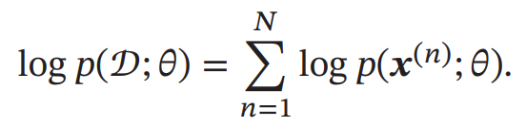
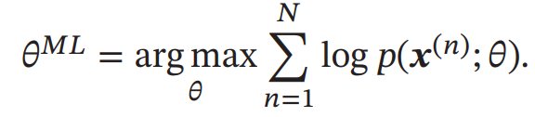
Density Estimation
Parametric Density Estimation
According to prior knowledge, it is assumed that random variables obey a certain distribution, and then the parameters of the distribution are estimated by training samples.
Estimation method: Maximum Likelihood Estimation (MLE)
Nonparametric Density Estimation
Without assuming that the data obeys a certain distribution, PDF of data is approximated by dividing the sample space into different regions and estimating the probability of each region.

Slide 6
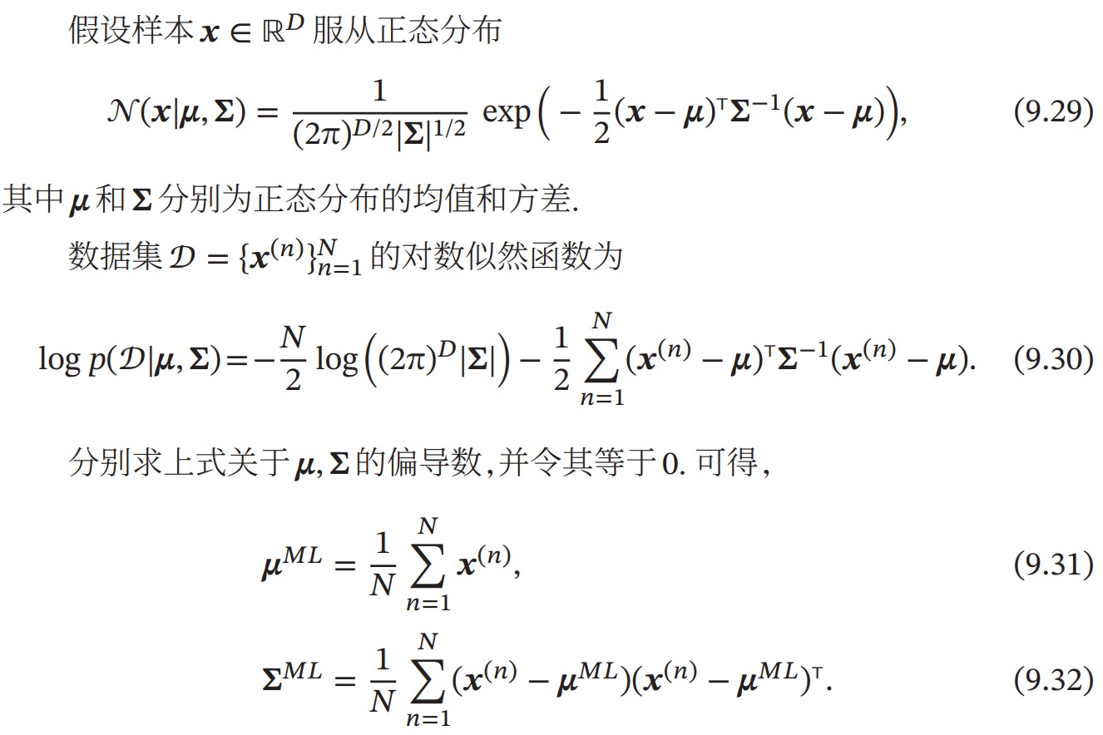
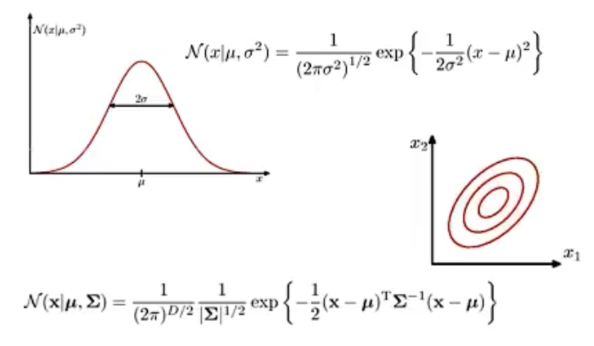
Parametric Density Estimation
Normal distribution:

Slide 7
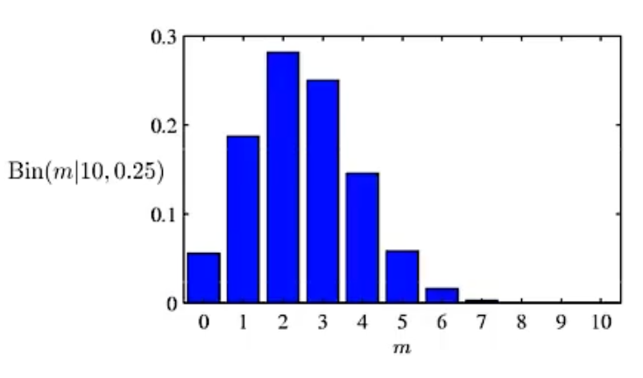
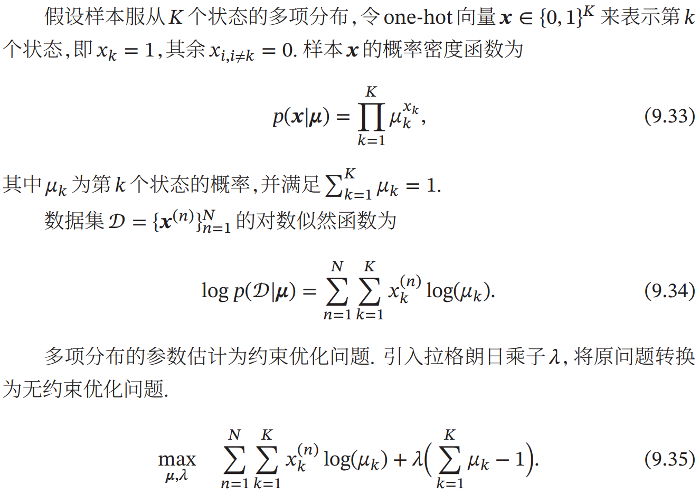
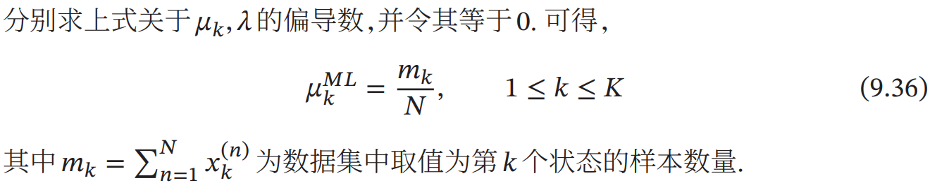
Parametric Density Estimation
Multinomial Distribution

Slide 8
Challenges in Parametric Density Estimation
Model selection
How to choose PDF of data distribution.
The distribution of actual data is often very complicated, rather than simple normal distribution or multinomial distribution.
Unobservable variables
The samples we use for training only contain some observable variables, and some very key variables are unobservable, which makes it difficult for us to accurately estimate the true distribution of data.
Dimension disaster problem
As dimensions increase, samples needed to estimate parameters increases exponentially. Over-fitting will occur when samples are insufficient.

Slide 9
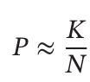
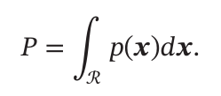
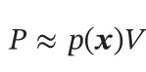
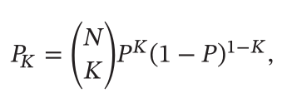
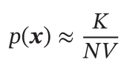
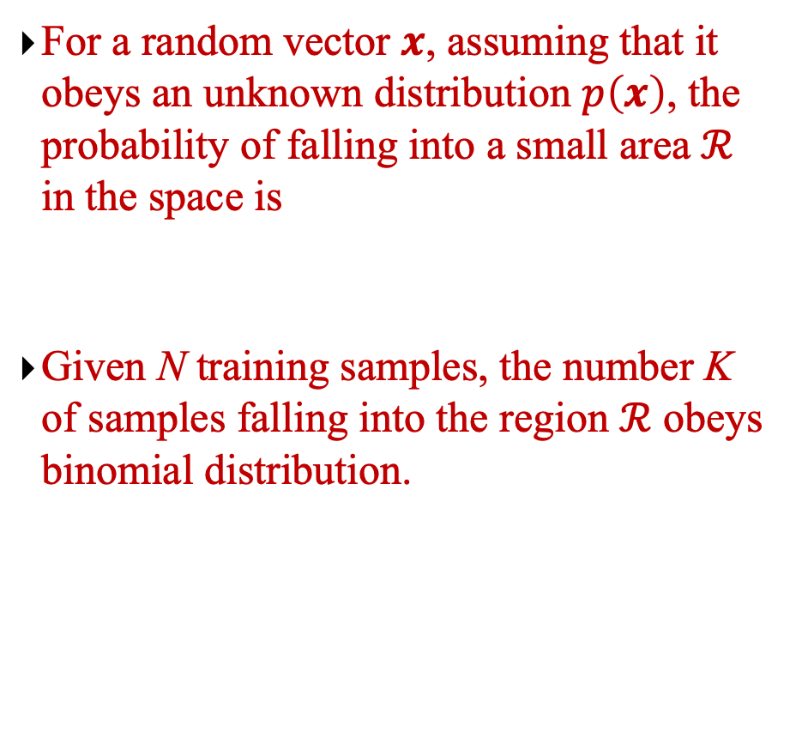
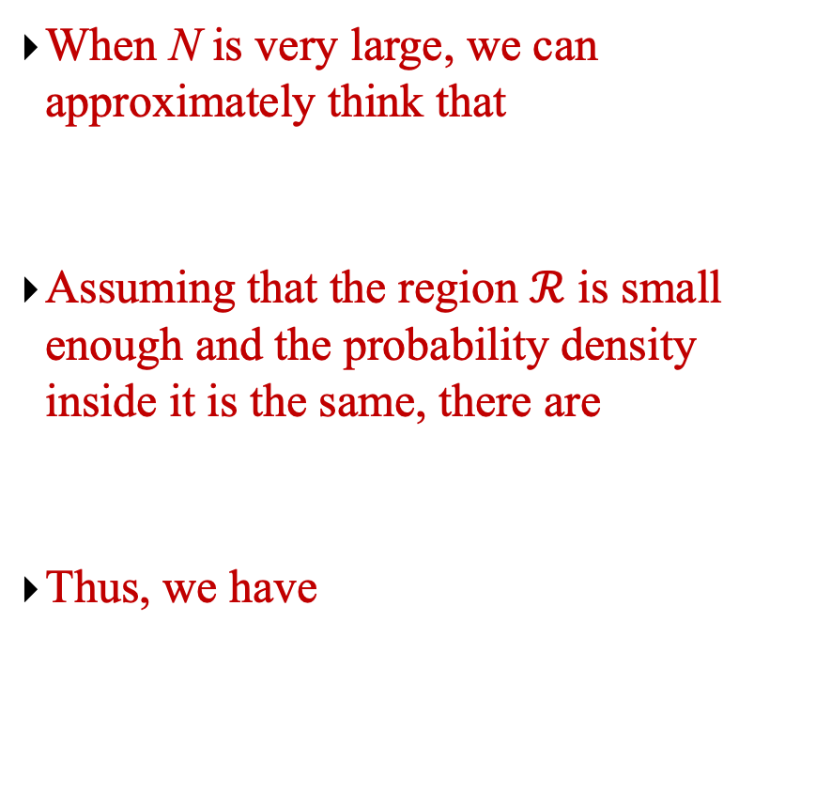
Nonparametric Density Estimation
For a random vector $x$, assuming that it obeys an unknown distribution $p\left(x\right)$, the probability of falling into a small area $ℛ$ in the space is
Given N training samples, the number K of samples falling into the region $ℛ$ obeys binomial distribution.
When N is very large, we can approximately think that
Assuming that the region $ℛ$ is small enough and the probability density inside it is the same, there are
Thus, we have

Slide 10
Nonparametric Density Estimation
To accurately estimate 𝑝(𝒙), it is necessary to make N large enough and V as small as possible. However, the number of samples is generally limited, and too small a region will lead to fewer samples falling into the region, so the estimated probability density is not accurate.
Fixed area size, counting the number falling into different areas, which includes histogram method and kernel method.
Changing the area size so that the number of samples falling into each area is zero is called K-nearest neighbor method.

Slide 11
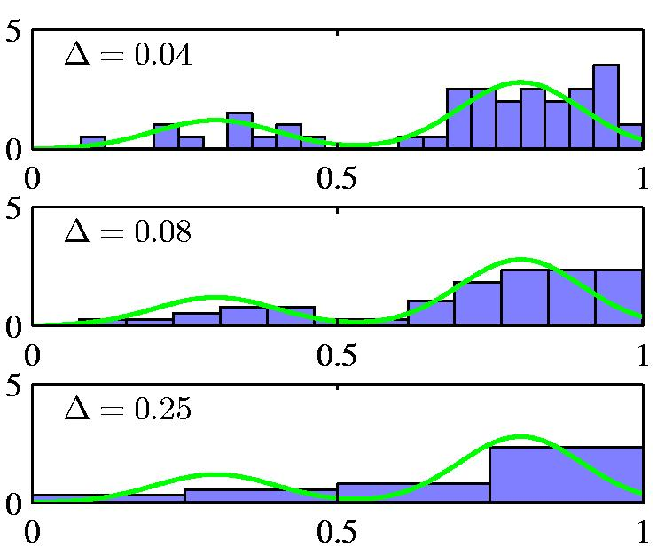
Histograms as density models
green curve is true density
For low dimensional data we can use a histogram as a density model.
How wide should the bins be? (width=regularizer)
Do we want the same bin-width everywhere?
Do we believe the density is zero for empty bins?
is too narrow
is too wide

Slide 12
Histograms as density estimators
There is no need to fit a model to the data.
We just compute some very simple statistics (the number of data points in each bin) and store them.
The number of bins is exponential in the dimensionality of the dataspace. So high-dimensional data is tricky:
We must either use big bins or get lots of zero counts (or adapt the local bin-width to the density)
The density has silly discontinuities at the bin boundaries.
We must be able to do better by some kind of smoothing.

Slide 13
Local density estimators
Estimate the density in a small region to be
Problem 1: Variance in estimate if K is small.
Problem 2: Unmodelled variation across the region if V is big compared with the smoothness of the true density
points in region
volume of region
total points

Slide 14
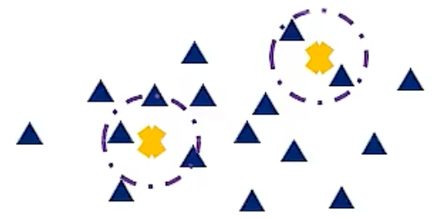
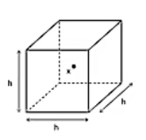
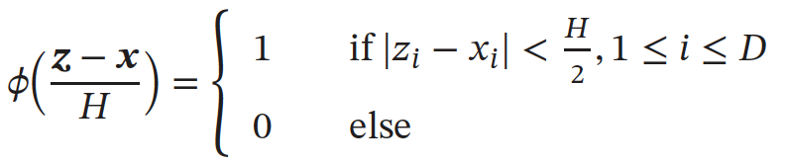
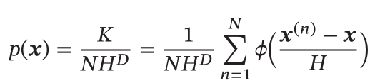
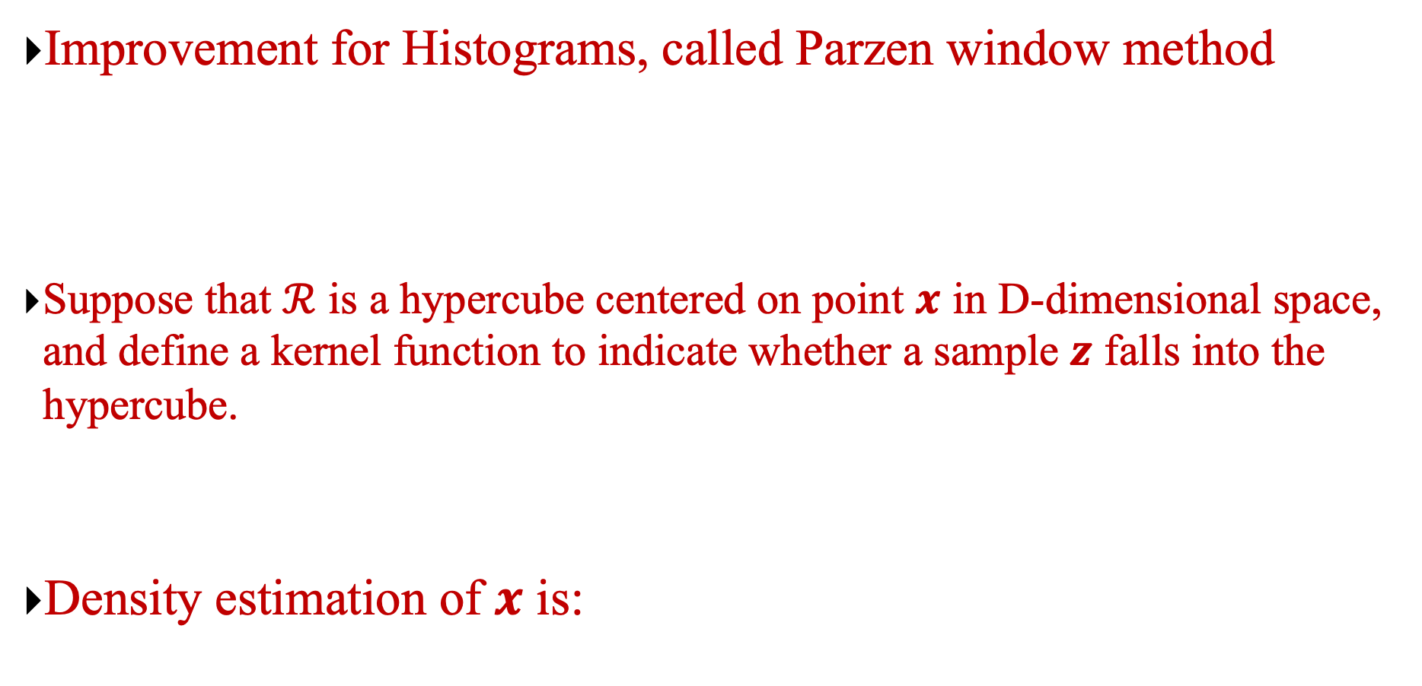
Kernel Density Estimation
Improvement for Histograms, called Parzen window method
Suppose that $ℛ$ is a hypercube centered on point $x$ in D-dimensional space, and define a kernel function to indicate whether a sample $z$ falls into the hypercube.
Density estimation of $x$ is:
Notes:
H

Slide 15
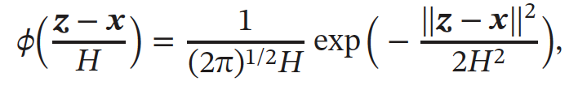
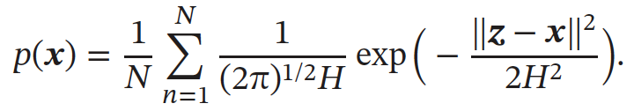
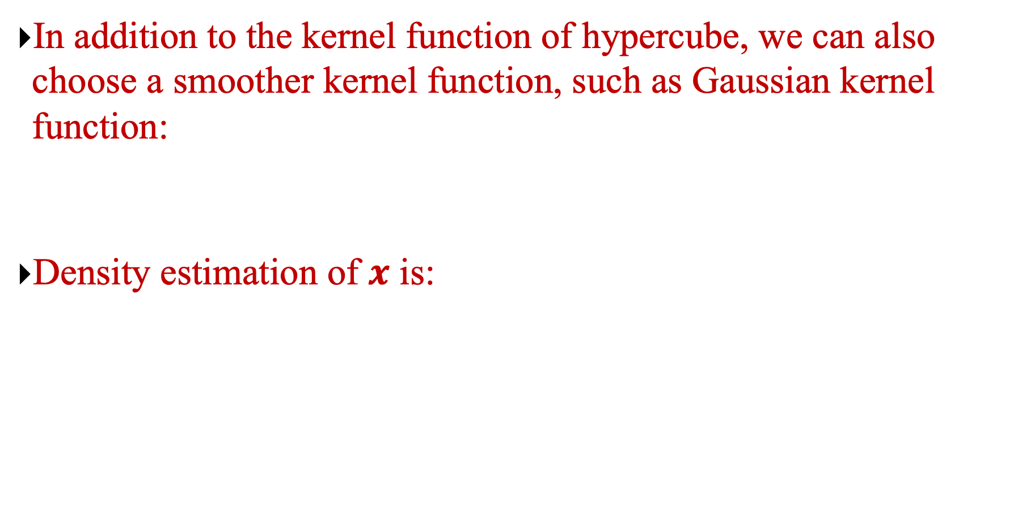
Kernel Density Estimation
In addition to the kernel function of hypercube, we can also choose a smoother kernel function, such as Gaussian kernel function:
Density estimation of $x$ is:
Notes:
H

Slide 16
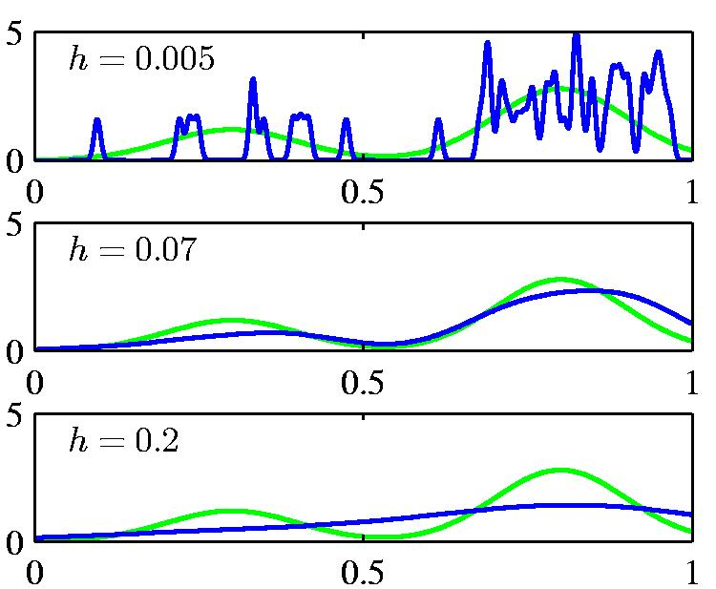
The density modeled by a kernel density estimator
is too narrow
is too wide

Slide 17
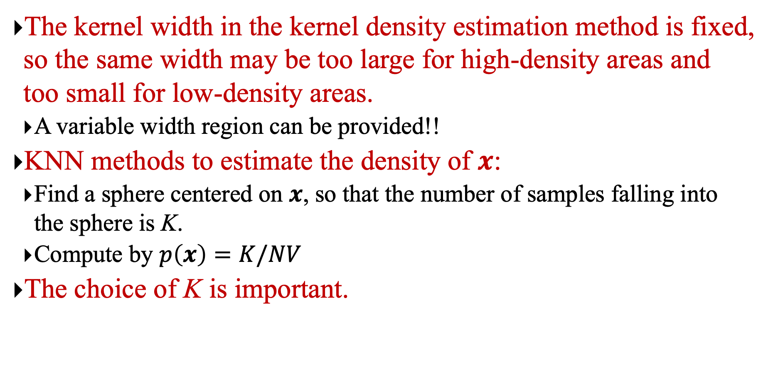
K-Nearest Neighbor (KNN) Method
The kernel width in the kernel density estimation method is fixed, so the same width may be too large for high-density areas and too small for low-density areas.
A variable width region can be provided!!
KNN methods to estimate the density of $x$:
Find a sphere centered on $x$, so that the number of samples falling into the sphere is K.
Compute by $p\left(x\right)=K/NV$
The choice of K is important.

Slide 18
KNN for classification and regression
Nearest neighbors is usually used for classification or regression:
For regression, average the predictions of the K nearest neighbors.
How should we pick K?
For classification, pick the class with the most votes.
How should we break ties?
Let the k’th nearest neighbor contribute a count that falls off with k.
For example,

Slide 19
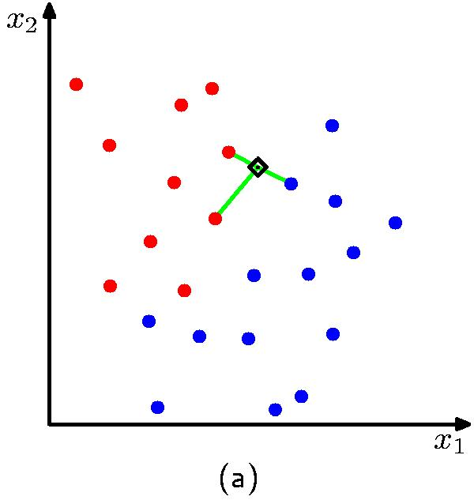
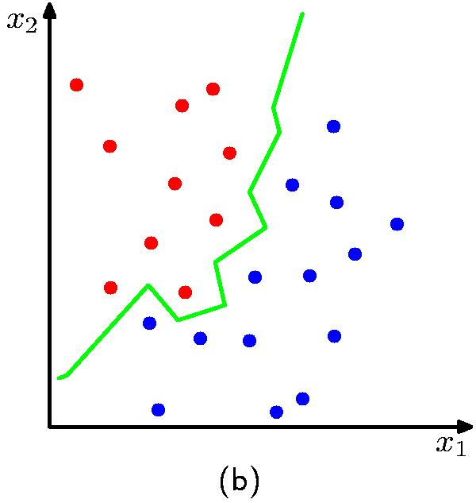
The decision boundary implemented by 3NN
The boundary is always the perpendicular bisector of the line between two points (Vornoi tesselation)

Slide 20
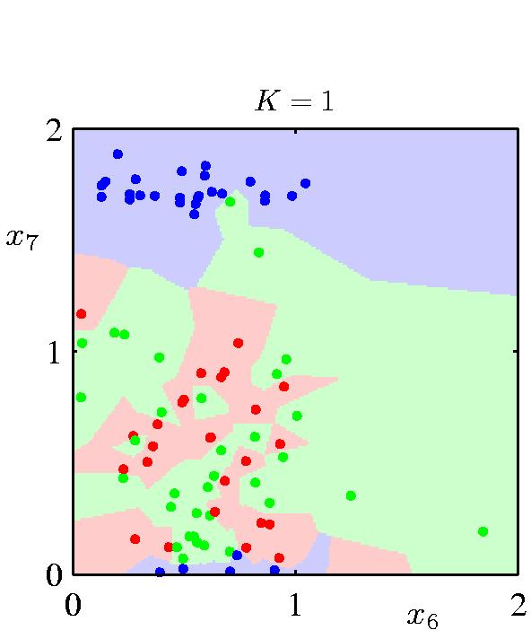
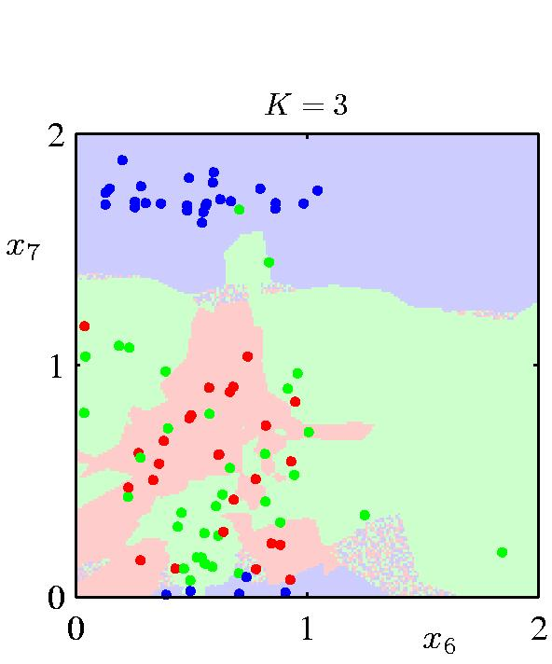
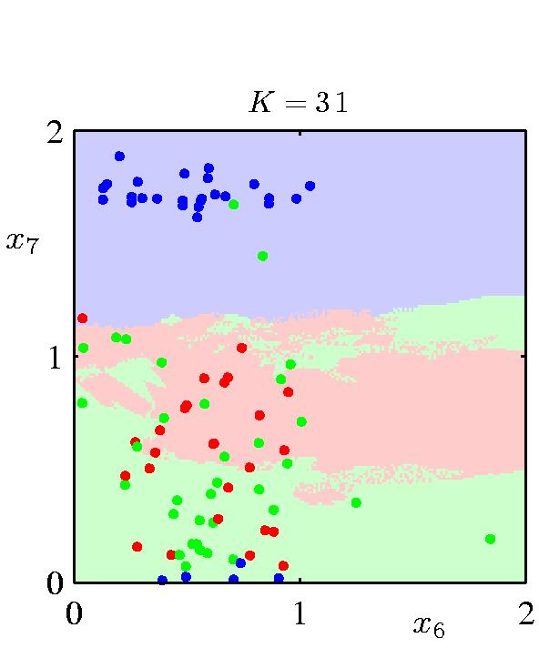
Regions defined by using various numbers of neighbors

Slide 21
Chapter 7.2: Mean-shift Algorithm

Slide 22
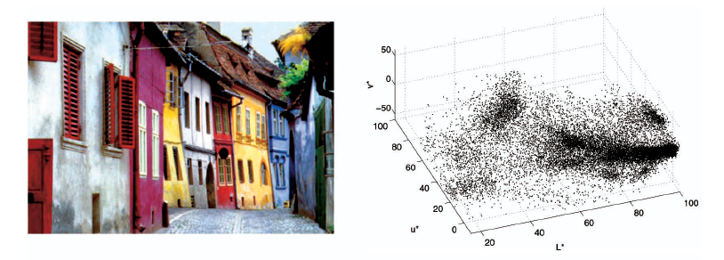
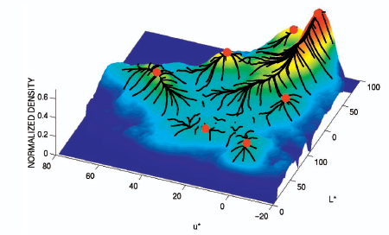
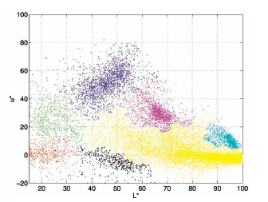
Mean-shift algorithm
Try to find modes of this non-parametric density

Slide 23
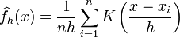
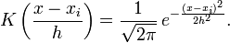
Kernel density estimation
A non-parametric clustering method
It often used for finding “blobs” (modes) in data, especially in computer vision and image segmentation
Kernel density estimation function
Gaussian kernel

Slide 24
Mean shift
Region of
interest
Center of
mass
Mean Shift
vector

Slide 25
Mean shift
Region of
interest
Center of
mass
Mean Shift
vector

Slide 26
Mean shift
Region of
interest
Center of
mass
Mean Shift
vector
Slide by Y. Ukrainitz & B. Sarel

Slide 27
Mean shift
Region of
interest
Center of
mass
Mean Shift
vector

Slide 28
Mean shift
Region of
interest
Center of
mass
Mean Shift
vector

Slide 29
Mean shift
Region of
interest
Center of
mass
Mean Shift
vector

Slide 30
Mean shift
Region of
interest
Center of
mass

Slide 31
Computing the Mean Shift
Simple Mean Shift procedure:
Compute mean shift vector
Translate the Kernel window by m(x)

Slide 32
Real Modality Analysis

Slide 33
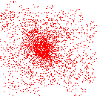
Attraction basin
Attraction basin: the region for which all trajectories lead to the same mode
Cluster: all data points in the attraction basin of a mode

Slide 34
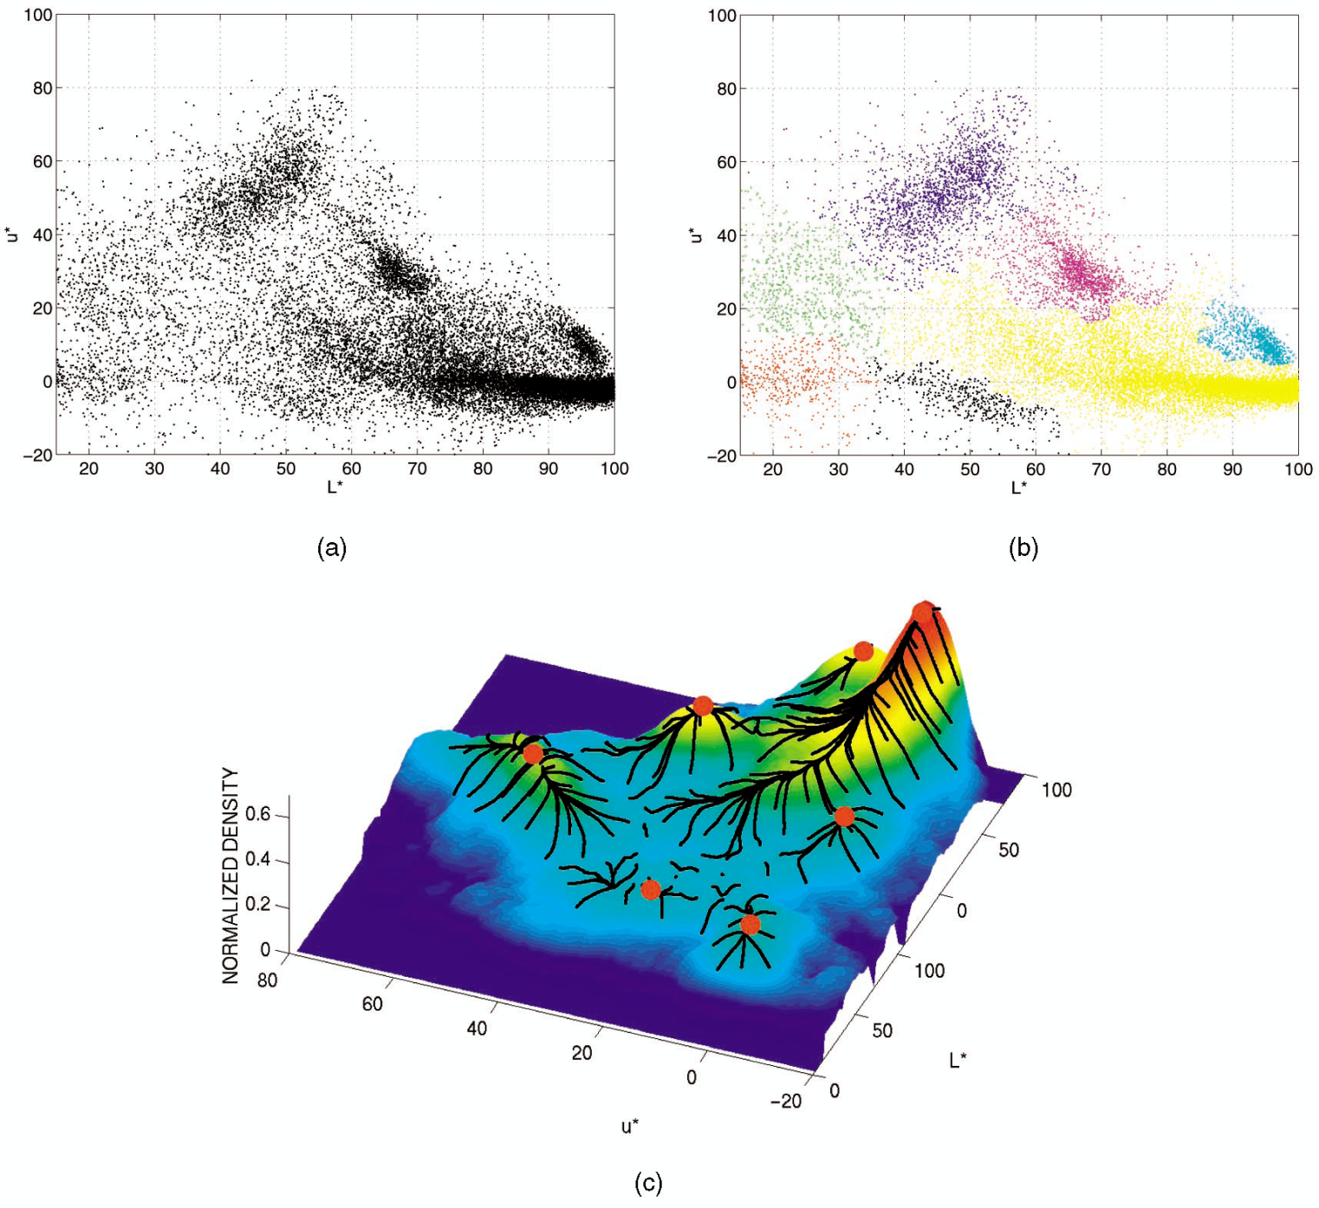
Attraction basin (吸引域)
Notes:
吸引盆地：在动力系统理论中，吸引盆地是一个区域，其中的初始条件最终会导致系统进入一个稳定的吸引子状态。

Slide 35
Mean shift clustering
The mean shift algorithm seeks modes of the given set of points
Choose kernel and bandwidth
For each point:
Center a window on that point
Compute the mean of the data in the search window
Center the search window at the new mean location
Repeat (b,c) until convergence
Group points that have converged to the same mean (mode), or apply additional techniques to refine the groups, such as merging small groups or applying morphological operations.

Slide 36

Segmentation by Mean Shift
Compute features for each pixel (color, gradients, texture, etc)
Set kernel size for features K_{f} and position K_{s}
Initialize windows at individual pixel locations
Perform mean shift for each window until convergence
Merge windows that are within width of K_{f} and K_{s}

Slide 37
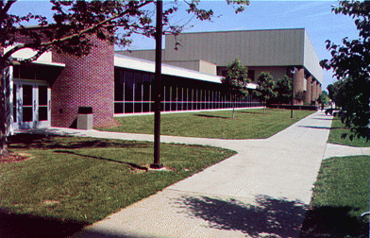
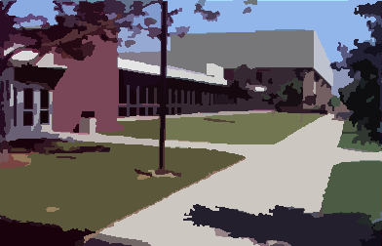
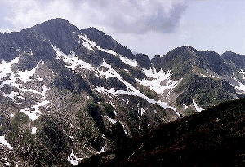
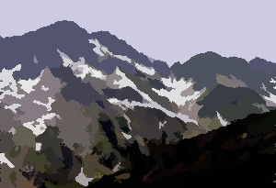
Mean shift segmentation
http://www.caip.rutgers.edu/~comanici/MSPAMI/msPamiResults.html

Slide 38
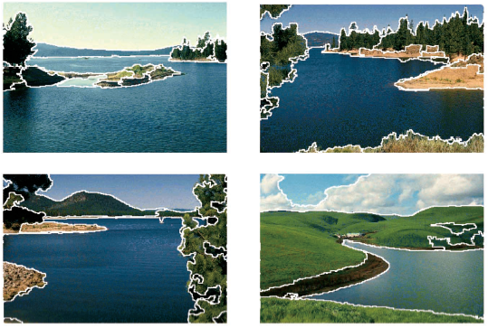
Mean shift segmentation

Slide 39
Mean-shift: issues
Speedups
Binned estimation
Fast search of neighbors
Update each window in each iteration (faster convergence)
Other tricks
Use kNN to determine window sizes adaptively
Lots of theoretical support
D. Comaniciu and P. Meer, Mean Shift: A Robust Approach toward Feature Space Analysis, PAMI 2002.
Notes:
Binned estimation is a statistical technique used to estimate the distribution of a dataset by dividing the data into discrete intervals or "bins." This method is particularly useful for visualizing and analyzing large datasets, as it simplifies the data and helps identify patterns, trends, and outliers.

Slide 40
Mean shift pros and cons
Pros
Good general-practice segmentation
Flexible in number and shape of regions
Robust to outliers
Cons
Have to choose kernel size in advance
Not suitable for high-dimensional features
When to use it
Oversegmentatoin
Multiple segmentations
Tracking, clustering, filtering applications

Slide 41
Chapter 7.3: Expectation Maximization

Slide 42
Silly Example
Let events be “grades in a class”
w₁ = Gets an A P(A) = ½
w₂ = Gets a B P(B) = μ
w₃ = Gets a C P(C) = 2μ
w₄ = Gets a D P(D) = ½-3μ
(Note 0 ≤ μ ≤1/6)
Assume we want to estimate μ from data. In a given class there were
a A’s
b B’s
c C’s
d D’s
What’s the maximum likelihood estimate of μ given a,b,c,d ?

Slide 43
Trivial Statistics
P(A) = ½ P(B) = μ P(C) = 2μ P(D) = ½-3μ
P( a,b,c,d | μ) = K(½)ª(μ)^{b}(2μ)^{c}(½-3μ)^{d}
log P( a,b,c,d | μ) = log K + alog ½ + blog μ + clog 2μ + dlog (½-3μ)
A | B | C | D
14 | 6 | 9 | 10
Boring, but true!

Slide 44
Same Problem with Hidden Information
Someone tells us that
Number of High grades (A’s + B’s) = h
Number of C’s = c
Number of D’s = d
What is the max. like estimate of μ now?
REMEMBER
P(A) = ½
P(B) = μ
P(C) = 2μ
P(D) = ½-3μ

Slide 45
Same Problem with Hidden Information
Someone tells us that
Number of High grades (A’s + B’s) = h
Number of C’s = c
Number of D’s = d
What is the max. like estimate of μ now?
We can answer this question circularly:
REMEMBER
P(A) = ½
P(B) = μ
P(C) = 2μ
P(D) = ½-3μ
EXPECTATION
If we know the value of μ we could compute the expected value of a and b
Since the ratio a:b should be the same as the ratio ½ : μ
MAXIMIZATION
If we know the expected values of a and b, we could compute the maximum likelihood value of μ

Slide 46
E.M. for our Trivial Problem
We begin with a guess for μ
We iterate between EXPECTATION and MAXIMIZATION to improve our estimates of μ and a and b.
Define μ(t) the estimate of μ on the t’th iteration
b(t) the estimate of b on t’th iteration
REMEMBER
P(A) = ½
P(B) = μ
P(C) = 2μ
P(D) = ½-3μ
E-step
M-step
Continue iterating until converged.
Good news: Converging to local optimum is assured.
Bad news: I said “local” optimum.

Slide 47
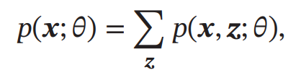
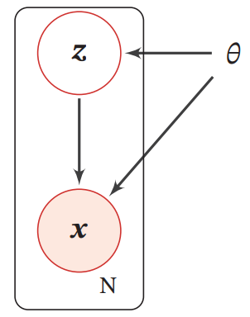
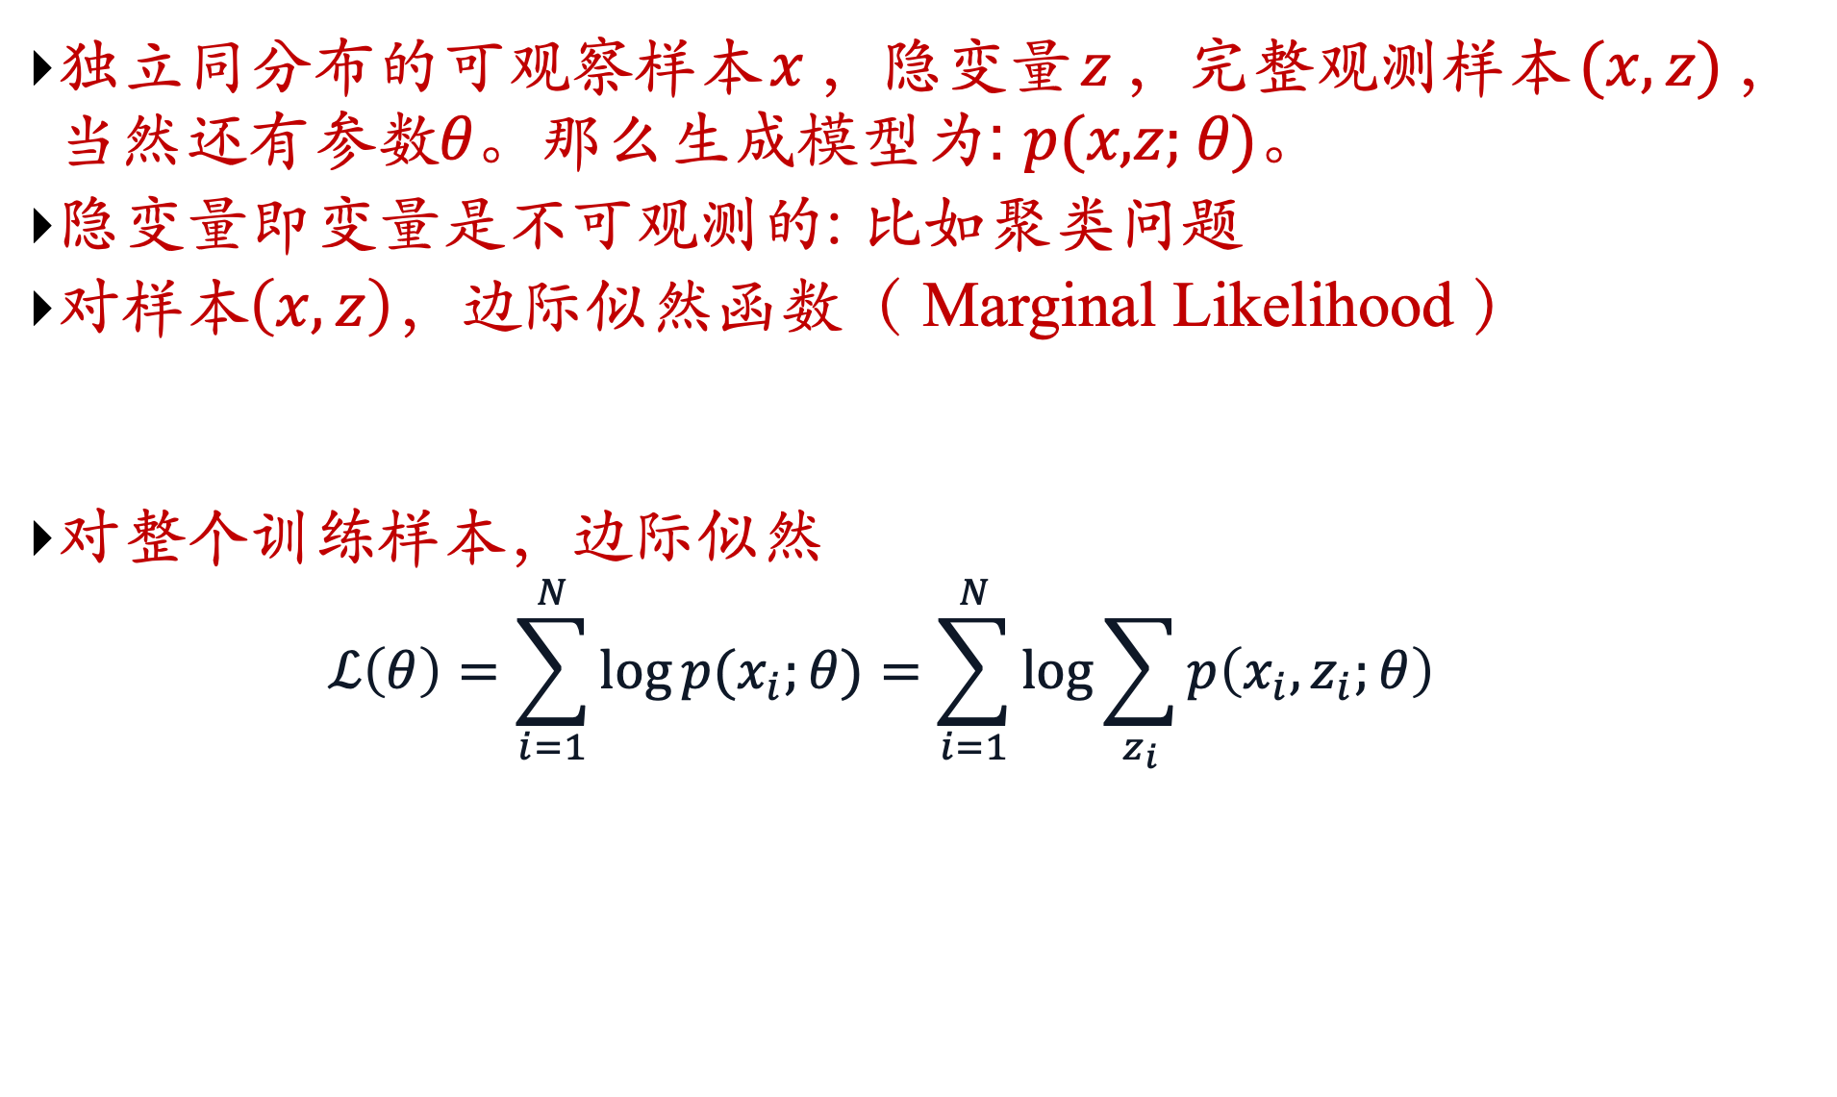
Parameter Learning with Hidden Variables (Optional)
独立同分布的可观察样本$x$，隐变量$z$，完整观测样本$(x,z)$，当然还有参数𝜃。那么生成模型为: 𝑝(𝑥,𝑧; 𝜃)。
隐变量即变量是不可观测的: 比如聚类问题
对样本$\left(x,z\right)$，边际似然函数（ Marginal Likelihood ）
对整个训练样本，边际似然
$$ℒ\left(θ\right)=\sum_{i=1}^{N}{\log{p(x_{i};θ)}}=\sum_{i=1}^{N}{\log{\sum_{z_{i}}{p\left(x_{i},z_{i};θ\right)}}}$$

Slide 48

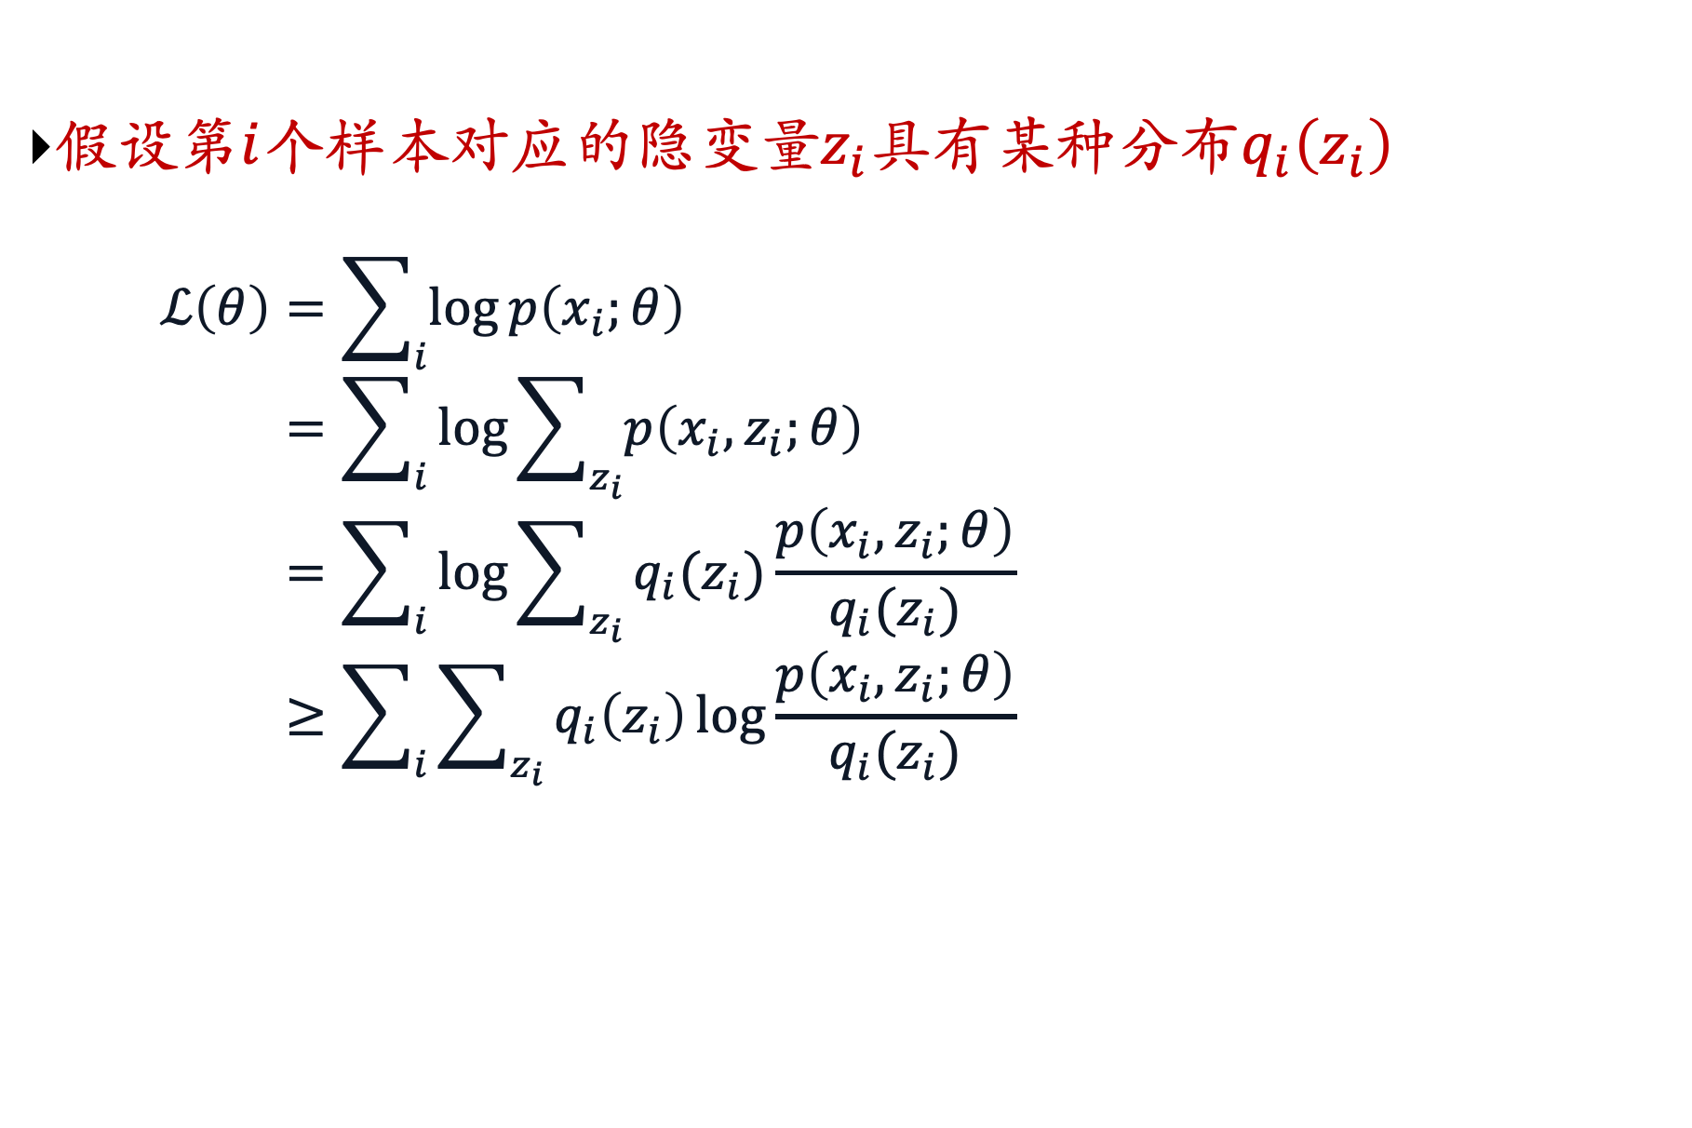
Algorithm Derivation (Optional)
假设第$i$个样本对应的隐变量$z_{i}$具有某种分布$q_{i}\left(z_{i}\right)$
$$ℒ\left(θ\right)=\sum_{i}{\log{p\left(x_{i};θ\right)}} \\ =\sum_{i}{\log{\sum_{z_{i}}{p\left(x_{i},z_{i};θ\right)}}} \\ =\sum_{i}{\log{\sum_{z_{i}}{q_{i}(z_{i})\frac{p\left(x_{i},z_{i};θ\right)}{q_{i}(z_{i})}}}} \\ ≥\sum_{i}{\sum_{z_{i}}{q_{i}\left(z_{i}\right)\log{\frac{p\left(x_{i},z_{i};θ\right)}{q_{i}(z_{i})}}}}$$
Jessen不等式，ln(E[X]) $≥$E[ln(x)]
确定了一个下界，在何时下届与原式相等？

Slide 49
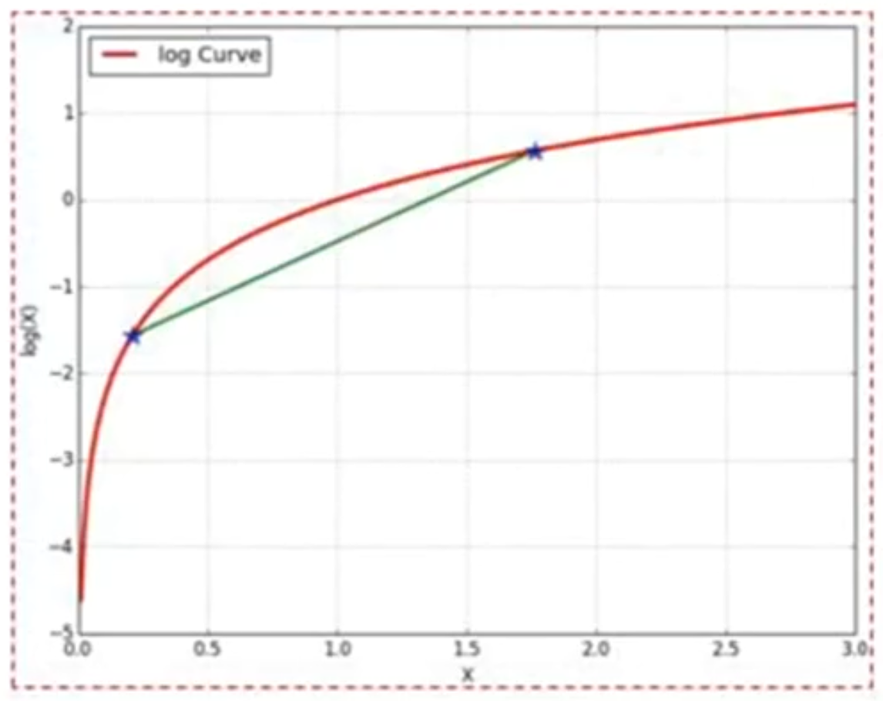
Jessen Inequality (Optional)

Slide 50
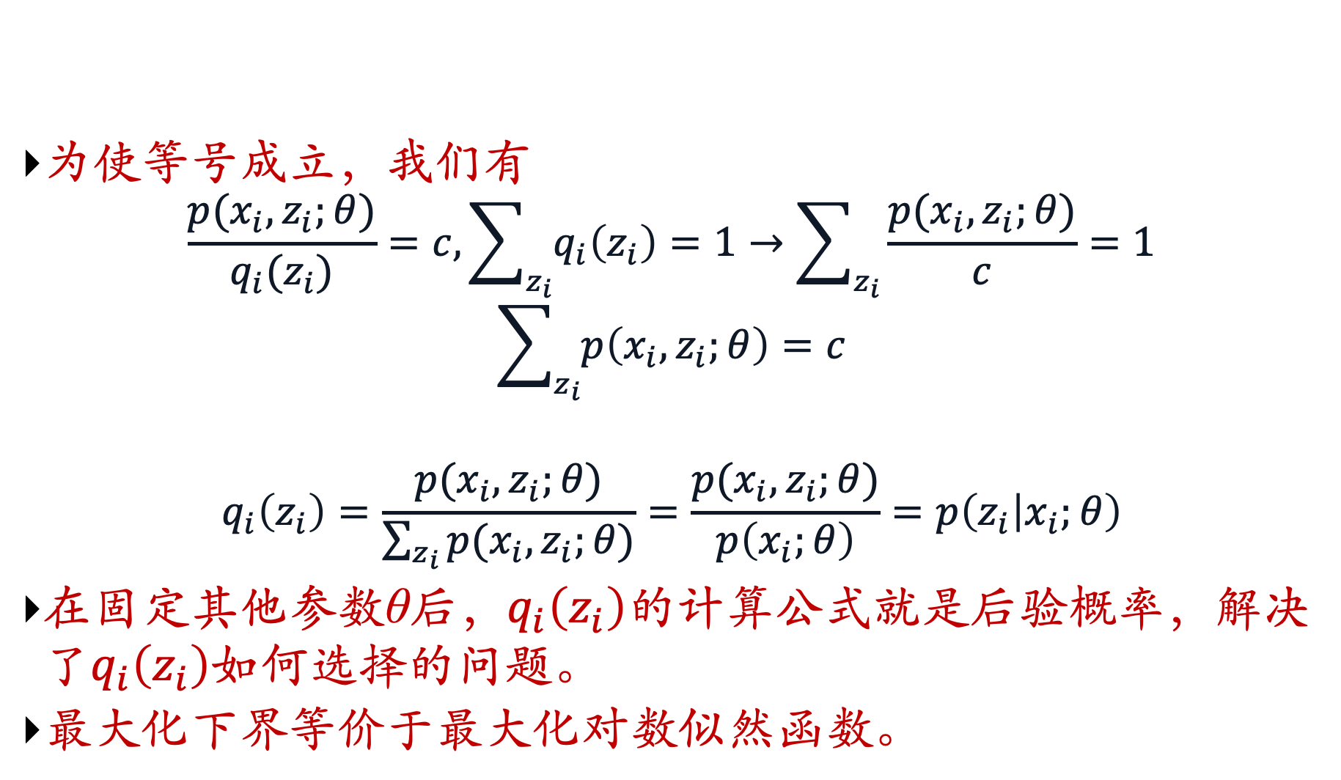
Looking for the Tightest Lower Bound (Optional)
为使等号成立，我们有
$$\frac{p(x_{i},z_{i};θ)}{q_{i}(z_{i})}=c, \sum_{z_{i}}{q_{i}\left(z_{i}\right)}=1→\sum_{z_{i}}{\frac{p(x_{i},z_{i};θ)}{c}}=1$$
$$\sum_{z_{i}}{p\left(x_{i},z_{i};θ\right)}=c$$
$$q_{i}\left(z_{i}\right)=\frac{p(x_{i},z_{i};θ)}{\sum_{z_{i}}{p(x_{i},z_{i};θ)}}=\frac{p(x_{i},z_{i};θ)}{p\left(x_{i};θ\right)}=p\left(z_{i} | x_{i};θ\right)$$
在固定其他参数θ后，$q_{i}\left(z_{i}\right)$的计算公式就是后验概率，解决了$q_{i}\left(z_{i}\right)$如何选择的问题。
最大化下界等价于最大化对数似然函数。

Slide 51

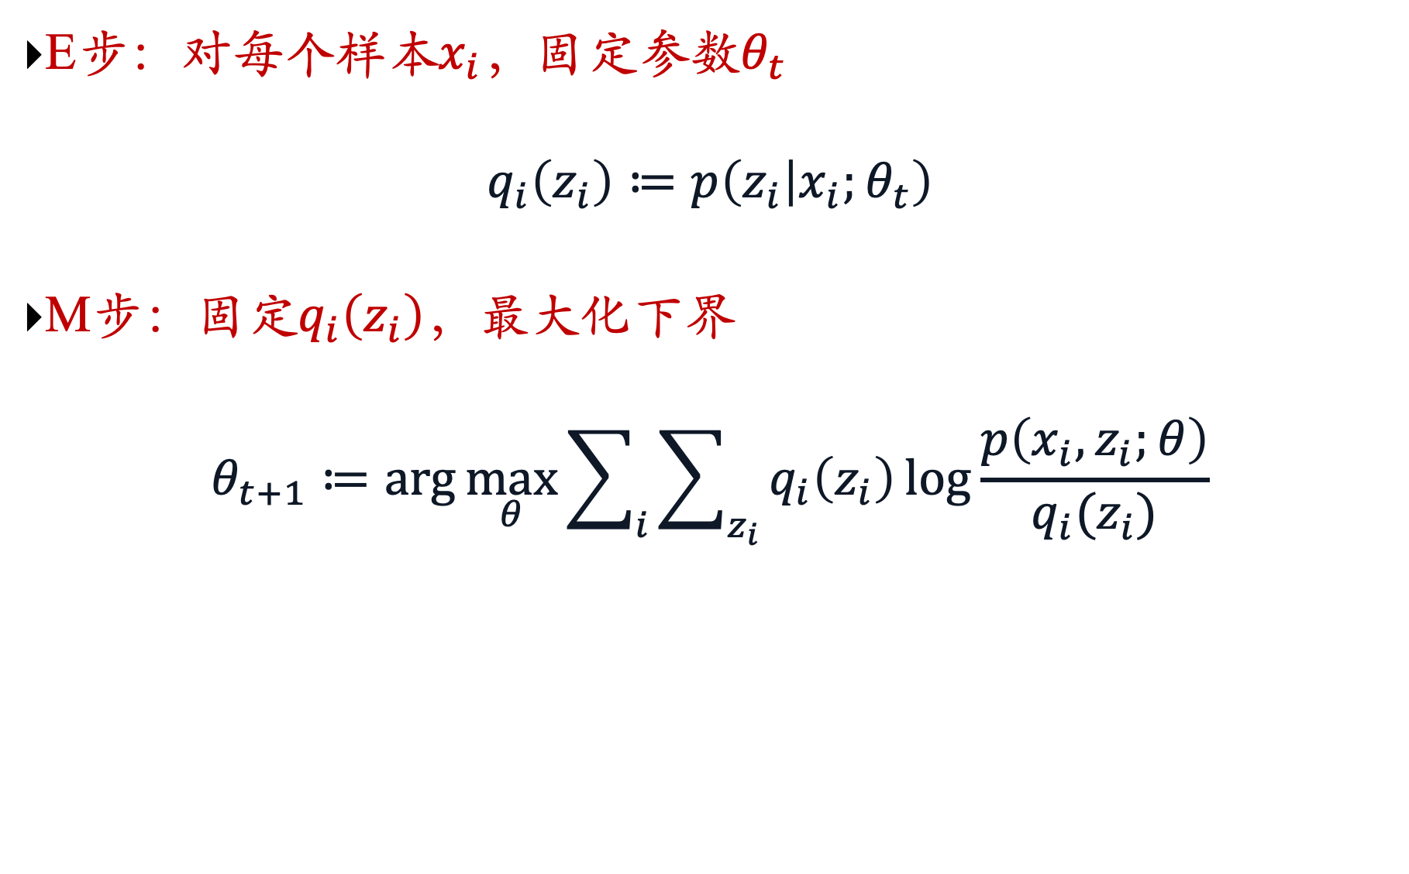
Overall framework of EM algorithm (Optional)
E步：对每个样本$x_{i}$，固定参数$θ_{t}$
$$q_{i}\left(z_{i}\right)≔p\left(z_{i} | x_{i};θ_{t}\right)$$
M步：固定$q_{i}\left(z_{i}\right)$，最大化下界
$$θ_{t+1}≔\arg{\max_{θ}}\sum_{i}{\sum_{z_{i}}{q_{i}\left(z_{i}\right)\log{\frac{p\left(x_{i},z_{i};θ\right)}{q_{i}(z_{i})}}}}$$
推断问题，复杂时采用变分推断
Evidence Lower Bound: $ELBO(q_{i},x_{i};θ)$

Slide 52
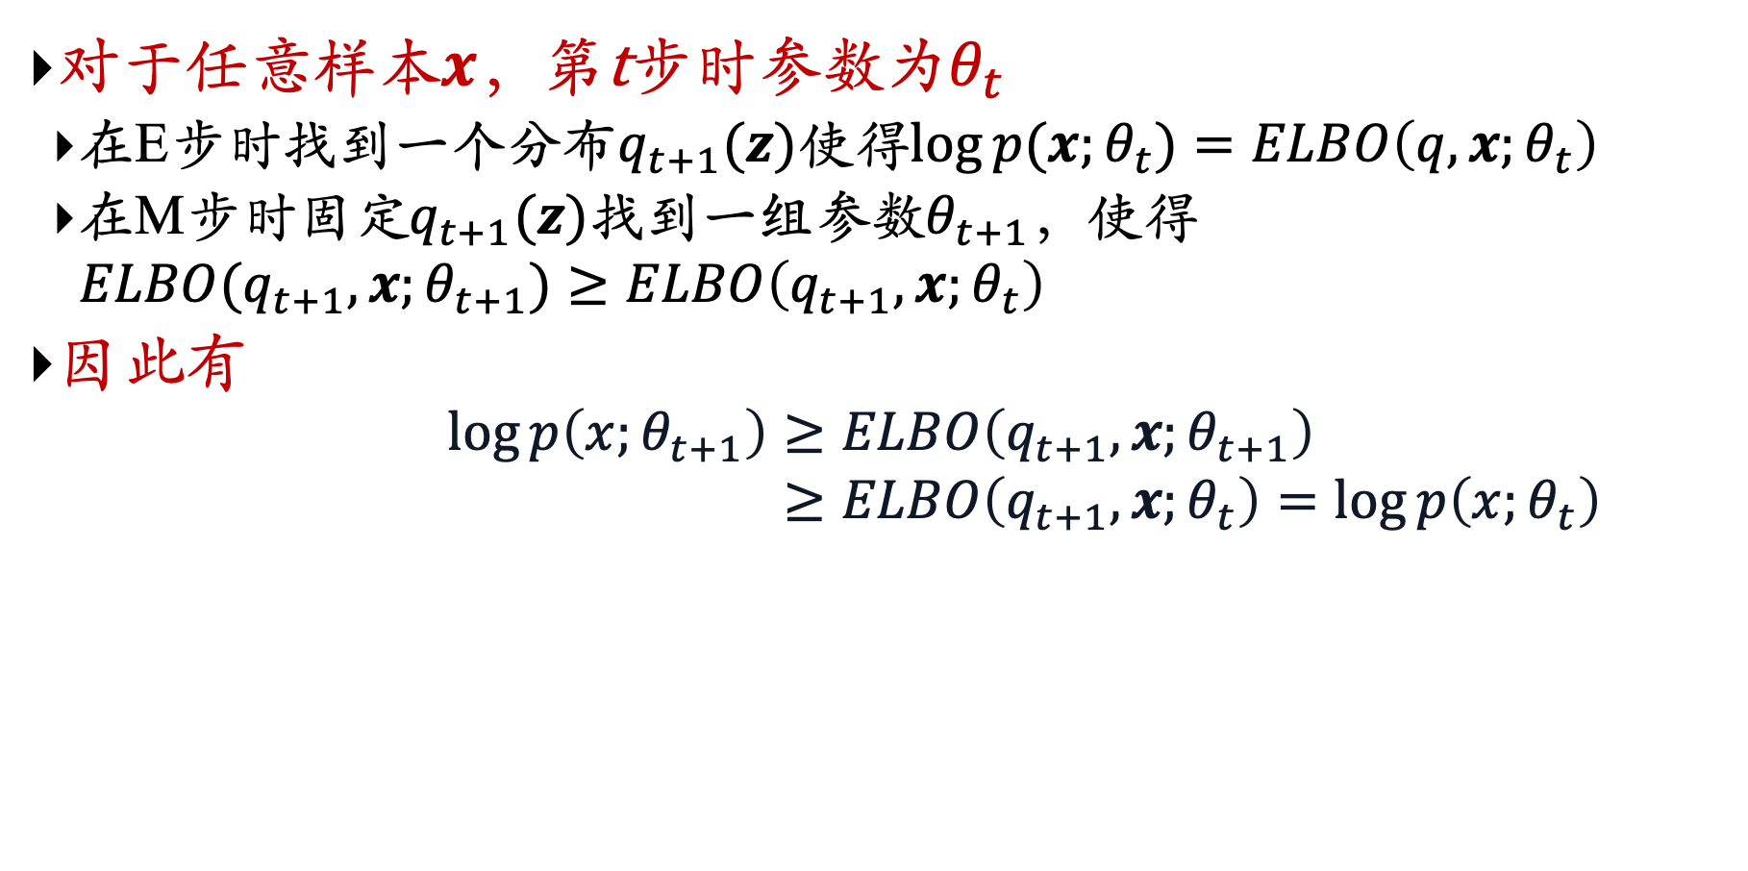
Convergence Proof (Optional)
对于任意样本$x$，第t步时参数为$θ_{t}$
在E步时找到一个分布$q_{t+1}(z)$使得$log⁡p(x;θ_{t})=ELBO\left(q, x;θ_{t}\right)$
在M步时固定$q_{t+1}(z)$找到一组参数$θ_{t+1}$，使得 $ELBO(q_{t+1}, x;θ_{t+1})≥ELBO\left(q_{t+1}, x;θ_{t}\right)$
因此有
$$\log{p\left(x;θ_{t+1}\right)}≥ELBO\left(q_{t+1}, x;θ_{t+1}\right) \\ ≥ELBO\left(q_{t+1}, x;θ_{t}\right)=\log{p\left(x;θ_{t}\right)}$$

Slide 53

Information Theory Perspective (Optional)

Slide 54

EM algorithm in the iteration of step t (Optional)

Slide 55
Chapter 7.4: Gaussian Mixture Models

Slide 56
Unsupervised Learning
You walk into a bar.
A stranger approaches and tells you:
“I’ve got data from K classes. Each class i produces observations with a normal distribution with mean μ_{i} and variance σ²I (Standard simple multivariate Gaussian assumptions). I can tell you all the P(w_{i})’s .”
So far, looks straightforward.
“I need a maximum likelihood estimate of the μ_{i}’s .“
No problem:
“There’s just one thing. None of the data are labeled. I have datapoints, but I don’t know what class they’re from (any of them!)
Uh oh!!

Slide 57

Bayes Classifier
$P\left(y=i\right)=P\left(w_{i}\right)=p_{i}$
$p\left(x | y=i\right)=𝒩\left(x;μ_{i},Σ_{i}\right)=\frac{1}{\sqrt{{\left(2π\right)}^{m}\left|Σ_{i}\right|}}\exp\left(−\frac{1}{2}{\left(x−μ_{i}\right)}^{T}Σ_{i}^{−1}\left(x−μ_{i}\right)\right)$
How do we deal with that?

Slide 58


Predicting wealth from age
$$𝒩\left(x;μ,σ\right)=\frac{1}{\sqrt{\left(2π\right)σ^{2}}}\exp\left(−\frac{{\left(x−μ\right)}^{2}}{2σ^{2}}\right)$$

Slide 59

Predicting wealth from age

Slide 60


Predict maker from model, year, and mpg
$$𝒩\left(x;μ,Σ\right)=\frac{1}{\sqrt{{\left(2π\right)}^{m}\left|Σ\right|}}\exp\left(−\frac{1}{2}{\left(x−μ\right)}^{T}Σ^{−1}\left(x−μ\right)\right)$$

Slide 61

General: O(m²) parameters

Slide 62


Aligned: O(m) parameters
Independent!!
$$𝒩\left(x;μ,Σ\right)=\frac{1}{\sqrt{{\left(2π\right)}^{m}}\prod_{i=1}^{m}{σ_{i}}}\exp\left(−\frac{1}{2}\sum_{i=1}^{m}{\frac{{\left(x_{i}−μ_{i}\right)}^{2}}{σ_{i}^{2}}}\right)$$

Slide 63

Aligned: O(m) parameters

Slide 64


Spherical: O(1) cov parameters
$$𝒩\left(x;μ,Σ\right)=\frac{1}{\sqrt{{\left(2π\right)}^{m}}σ^{m}}\exp\left(−\frac{1}{2}\sum_{i=1}^{m}{\frac{{\left(x_{i}−μ_{i}\right)}^{2}}{σ^{2}}}\right)$$
Standard simple multivariate Gaussian assumption:

Slide 65

Spherical: O(1) cov parameters

Slide 66
Making a Classifier from a Density Estimator
Categorical inputs only
Real-valued inputs only
Mixed Real / Cat okay
Predict
category
Joint BC
Naïve BC
Gauss BC
Dec Tree
Inputs
Classifier
Density
Estimator
Prob-
ability
Joint DE
Naïve DE
Gauss DE
Inputs
Predict
real no.
Inputs
Regressor

Slide 67

Density Estimation
What if we want to do density estimation with multimodal or clumpy data?

Slide 68


GMM: 1-Dimension definition
由多个高斯分布组成的模型，其总体密度函数为多个高斯密度函数的加权组合
假设样本𝑥是从𝐾个高斯分布中的一个分布生成的
引入隐变量 𝑧 ∈ {1, ⋯ , 𝐾}，则有$p\left(z=k;π\right)=π_{k}，1≤k≤K$
这里$π=[π_{1},π_{2},⋯,π_{K}]$
给定$z=k$，条件分布$p(x|z=k)$为高斯分布

Slide 69



GMM: 1-Dimension definition
从GMM中生成一个样本$x$的过程可以分为两步：
首先根据多项分布𝑝(𝑧; 𝝅)随机选取一个高斯分布.
假设选中第𝑘个高斯分布（即 𝑧 = 𝑘），再从高斯分布$𝒩\left(x;μ_{k}, σ_{k}\right)$中 选取一个样本𝑥.
随机变量𝑥的概率密度函数为

Slide 70
GMM: m-dimension definition
There are K components. The i’th component is called ω_{i}
Component ω_{i} has an associated mean vector μ_{i}
μ₂
μ₁
μ₃

Slide 71
GMM: m-dimension definition
There are K components. The i’th component is called ω_{i}
Component ω_{i} has an associated mean vector μ_{i}
Each component generates data from a Gaussian with mean μ_{i} and covariance matrix σ²I
Assume that each datapoint is generated according to the following recipe:
μ₂
μ₁
μ₃

Slide 72
GMM: m-dimension definition
There are K components. The i’th component is called ω_{i}
Component ω_{i} has an associated mean vector μ_{i}
Each component generates data from a Gaussian with mean μ_{i} and covariance matrix σ²I
Assume that each datapoint is generated according to the following recipe:
Pick a component at random. Choose component i with probability P(ω_{i}).
μ₂

Slide 73
GMM: m-dimension definition
There are K components. The i’th component is called ω_{i}
Component ω_{i} has an associated mean vector μ_{i}
Each component generates data from a Gaussian with mean μ_{i} and covariance matrix σ²I
Assume that each datapoint is generated according to the following recipe:
Pick a component at random. Choose component i with probability P(ω_{i}).
Datapoint ~ N(μ_{i}, σ²I )
μ₂
x

Slide 74
GMM: m-dimension definition (General)
There are K components. The i’th component is called ω_{i}
Component ω_{i} has an associated mean vector μ_{i}
Each component generates data from a Gaussian with mean μ_{i} and covariance matrix Σ_{i}
Assume that each datapoint is generated according to the following recipe:
Pick a component at random. Choose component i with probability P(ω_{i}).
Datapoint ~ N(μ_{i}, Σ_{i} )
μ₂
μ₁
μ₃

Slide 75
Unsupervised Learning: not as hard as it looks
 | Sometimes easy
 | Sometimes impossible
 | and sometimes in between
IN CASE YOU’RE WONDERING WHAT THESE DIAGRAMS ARE, THEY SHOW 2-d UNLABELED DATA (X VECTORS) DISTRIBUTED IN 2-d SPACE. THE TOP ONE HAS THREE VERY CLEAR GAUSSIAN CENTERS

Slide 76


GMM’s Parameter Estimation
目标：给定𝑁个由GMM生成的训练样本 $x^{(1)},x^{(2)}, ⋯ ,x^{(N)}$，希望 能学习其中的参数 $π_{k}, μ_{k}, σ_{k}, 1≤k≤K.$
对每个样本$x^{(n)}$，对数边际分布为
可采用EM算法，分两步进行.

Slide 77


EM Algorithm (E step)
先固定参数$μ, σ$，计算后验分布$p\left(z^{\left(n\right)} | x^{\left(n\right)}\right)$.
$$p\left(z^{\left(n\right)}=k | x^{\left(n\right)}\right)=\frac{p\left(z^{\left(n\right)}=k\right)p\left(x^{\left(n\right)} | z^{\left(n\right)}=k\right)}{p\left(x^{\left(n\right)}\right)} \\ =\frac{π_{k}𝒩\left(x^{\left(n\right)};μ_{k},σ_{k}\right)}{\sum_{k^{′}=1}^{K}{π_{k^{′}}𝒩\left(x^{\left(n\right)};μ_{k^{′}},σ_{k^{′}}\right)}}$$
$$γ_{nk}$$

Slide 78


EM Algorithm (M step)
令$q_{n}\left(z=k\right)=γ_{nk}$，训练集$𝒟={\{x^{\left(n\right)}\}}_{n=1}^{N}$的证据下界为
$$ELBO\left(γ,\text{𝒟}\text{;} π,μ,σ\right)=\sum_{n=1}^{N}{\sum_{k=1}^{K}{γ_{nk}\log{\frac{p\left(x^{\left(n\right)},z^{\left(n\right)}=k\right)}{γ_{nk}}}}} \\ =\sum_{n=1}^{N}{\sum_{k=1}^{K}{γ_{nk}\left(\log{𝒩\left(x^{\left(n\right)};μ_{k},σ_{k}\right)}+\log{\frac{π_{k}}{γ_{nk}}}\right)}} \\ =\sum_{n=1}^{N}{\sum_{k=1}^{K}{γ_{nk}\left(\frac{−{\left(x^{\left(n\right)}−μ_{k}\right)}^{2}}{2σ_{k}^{2}}−\log{σ_{k}}+\log{π_{k}}\right)}+C}$$
转化为优化问题

Slide 79


EM Algorithm (M step)

Slide 80

GMM Training Process

Slide 81
Computing likelihoods in unsupervised case
We have x₁ , x_{2 , …} x_{N}
We know P(w₁) P(w₂) .. P(w_{K})
We know σ
P(x|w_{i}, μ_{i}, … μ_{K}) = Prob that an observation from class w_{i} would have value x given class means μ₁… μ_{K}
Can we write an expression for that?

Slide 82
Likelihoods in unsupervised case
We have x₁ x₂ … x_{N}
We have P(w₁) .. P(w_{K}), and σ.
We can define, for any x , P(x|w_{i}, μ₁, μ₂ .. μ_{K})
Can we define P(x | μ₁, μ₂ .. μ_{K}) ?
Can we define P(x₁, x₁, … x_{N} | μ₁, μ₂ .. μ_{K}) ?
[YES, IF WE ASSUME THE X₁’S WERE DRAWN INDEPENDENTLY]

Slide 83

Likelihoods in unsupervised case
We now have a procedure s.t. if you give me a guess at μ₁, μ₂ .. μ_{K,}
I can tell you the prob of the unlabeled data given those μ‘s.
Suppose x‘s are 1-dimensional.
There are two classes; w₁ and w₂
P(w₁) = 1/3 P(w₂) = 2/3 σ = 1 .
There are 25 unlabeled datapoints
(From Duda and Hart)
x₁ = 0.608
x₂ = -1.590
x₃ = 0.235
x₄ = 3.949
:
x₂₅ = -0.712

Slide 84

Duda & Hart’s Example
Graph of
log P(x₁, x₂ .. x₂₅ | μ₁, μ₂ )
against μ₁ (→) and μ₂ (↑)
Max likelihood = (μ₁ =-2.13, μ₂ =1.668)
Local minimum, but very close to global at (μ₁ =2.085, μ₂ =-1.257)*
* corresponds to switching w₁ + w₂.

Slide 85

Duda & Hart’s Example
We can graph the prob. dist. function of data given our μ₁ and μ₂ estimates.
We can also graph the true function from which the data was randomly generated.
They are close. Good.
The 2nd solution tries to put the “2/3” hump where the “1/3” hump should go, and vice versa.
In this example unsupervised is almost as good as supervised. If the x₁ .. x₂₅ are given the class which was used to learn them, then the results are (μ₁=-2.176, μ₂=1.684). Unsupervised got (μ₁=-2.13, μ₂=1.668).

Slide 86

Finding the max likelihood μ₁,μ₂ ,... , μ_{K}
We can compute P( data | μ₁,μ₂…μ_{K})
How do we find the μ_{i}‘s which give max. likelihood?
The normal max likelihood trick:
Set $\frac{∂}{∂μ_{i}}\log{\text{Prob}\text{ (….)}}$
and solve for μ_{i}‘s.
# Here you get non-linear non-analytically-solvable equations
Use gradient descent
Slow but doable
Use a much faster, cuter, and recently very popular method…

Slide 87

Unsupervised Learning of GMMs
Remember:
We have unlabeled data x₁ x₂ … x_{N}
We know there are K classes
We know P(w₁) P(w₂) P(w₃) … P(w_{K})
We don’t know μ₁ μ₂ … μ_{K}
We can write P( data | μ₁…. μ_{K})
$$\begin{matrix} & =p\left(x_{1}…x_{N}∣μ_{1}…μ_{K}\right) \\ & \begin{aligned}=\prod_{i=1}^{N}{p\left(x_{i}∣μ_{1}…μ_{K}\right)} \\ \begin{aligned}=\prod_{i=1}^{N}{\sum_{j=1}^{K}{p\left(x_{i}∣w_{j},μ_{1}…μ_{K}\right)P\left(w_{j}\right)}} \\ ∝\prod_{i=1}^{N}{\sum_{j=1}^{K}{exp\left(−\frac{1}{2σ^{2}}{\left(x_{i}−μ_{j}\right)}^{2}\right)P\left(w_{j}\right)}}\end{aligned}\end{aligned} \\ & \\ & \end{matrix}$$

Slide 88

E.M. for GMMs
For maximum likelihood, we have $\frac{∂}{∂μ_{j}}Prob\left(data \right| μ_{1}…μ_{K})=0$
Thus, for each class $w_{j}$:
$$μ_{j}=\frac{\sum_{i=1}^{N}{P\left(w_{j}|x_{i},μ_{1}…μ_{K}\right)x_{i}}}{\sum_{i=1}^{N}{P\left(w_{j}|x_{i},μ_{1}…μ_{K}\right)}}$$
This is K nonlinear equations in μ_{j}’s.”
If, for each x_{i} we knew that for each w_{j} the prob that μ_{j} was in class w_{j} is P(w_{j}|x_{i},μ₁…μ_{K}) Then… we would easily compute μ_{j}.
If we knew each μ_{j} then we could easily compute P(w_{j}|x_{i},μ₁…μ_{K}) for each w_{j} and x_{i}.
…I feel an EM experience coming on!!

Slide 89
E.M. for GMMs
Iterate. On the t’th iteration let our estimates be
λ_{t} = {μ₁(t), μ₂(t) … μ_{c}(t)}
E-step
Compute “expected” classes of all datapoints for each class
Just evaluate a Gaussian at x_{k}
M-step.
Compute Max. like μ given our data’s class membership distributions

Slide 90

E.M. Convergence
This algorithm is REALLY USED. And in high dimensional state spaces, too. E.G. Vector Quantization for Speech Data

Slide 91
E.M. for General GMMs
Iterate. On the t’th iteration let our estimates be
λ_{t} = {μ₁(t), μ₂(t) … μ_{c}(t), Σ₁(t), Σ₂(t) … Σ_{c}(t), p₁(t), p₂(t) … p_{c}(t)}
E-step
Compute “expected” classes of all datapoints for each class
p_{i}(t) is shorthand for estimate of P(ω_{i}) on t’th iteration
Just evaluate a Gaussian at x_{k}
M-step.
Compute Max. like μ given our data’s class membership distributions
R = #records (N)

Slide 92


GMM Parameter Learning

Slide 93
Chapter 7.5: Self-Organized Map

Slide 94
Self-Organizing Maps
1. What is a Self-Organizing Map?
2. Topographic Maps
3. Setting up a Self-Organizing Map
4. Kohonen Networks
5. Components of Self Organization
6. Overview of the SOM Algorithm

Slide 95
What is a self-organizing map (SOM)?
One particularly interesting class of unsupervised system is based on competitive learning, in which the output neurons compete amongst themselves to be activated, with the result that only one is activated at any one time.
This activated neuron is called a winner-takes all neuron or simply the winning neuron. Such competition can be induced/implemented by having lateral inhibition (横向抑制) connections (negative feedback paths) between the neurons.
The result is that the neurons are forced to organize themselves. For obvious reasons, such a network is called a Self-Organizing Map (SOM)
Notes:
自组织映射（Self-Organizing Maps，简称SOM）是一种无监督学习的人工神经网络，主要用于数据的降维、聚类和可视化。它通过将高维数据映射到低维空间（通常是二维）来帮助人们理解数据的结构和模式。

Slide 96
Set up SOM
The principal goal of an SOM is to transform an incoming signal pattern of arbitrary dimension into a one or two dimensional discrete map, and to perform this transformation adaptively in a topologically ordered fashion.
We therefore set up our SOM by placing neurons at the nodes of a one or two dimensional lattice. Higher dimensional maps are also possible, but not so common.
The neurons become selectively tuned to various input patterns (stimuli) or classes of input patterns during the course of the competitive learning.
The locations of the neurons so tuned (i.e. the winning neurons) become ordered and a meaningful coordinate system for the input features is created on the lattice. The SOM thus forms the required topographic map (地形图) of the input patterns.
Notes:
Topologically ordered fashion: the mapping preserves the topological properties of the input space, allowing similar data points to be represented close to each other in the output space.
Topology refers to the arrangement and relationships between different nodes in the network. A topologically ordered map maintains the spatial relationships of the input data, meaning that similar inputs will activate nearby nodes on the map.

Slide 97
The Architecture a Self-Organizing Map
We shall concentrate on the SOM system known as a Kohonen Network. This has a feed-forward structure with a single computational layer of neurons arranged in rows and columns. Each neuron is fully connected to all the source units in the input layer:
A one dimensional map will just have a single row or column in the computational layer.

Slide 98
Components of Self Organization
The self-organization process involves four major components:
Initialization: All the connection weights are initialized with small random values.
Competition: For each input pattern, the neurons compute their respective values of a discriminant function which provides the basis for competition. The particular neuron with the smallest value of the discriminant function is declared the winner.
Cooperation: The winning neuron determines the spatial location of a topological neighborhood of excited neurons, thereby providing the basis for cooperation among neighboring neurons.
Adaptation: The excited neurons decrease their individual values of the discriminant function in relation to the input pattern through suitable adjustment of the associated connection weights, such that the response of the winning neuron to the subsequent application of a similar input pattern is enhanced.

Slide 99
The Competitive Process
If the input space is D dimensional (i.e. there are D input units) we can write the input patterns as x = {x_{i} : i = 1, …, D} and the connection weights between the input units i and the neurons j in the computation layer can be written w_{j} = {w_{ji} : j = 1, …, N; i = 1, …, D} where N is the total number of neurons.
We can then define our discriminant function to be the squared Euclidean distance between the input vector x and the weight vector w_{j} for each neuron j
In other words, the neuron whose weight vector comes closest to the input vector (i.e. is most similar to it) is declared the winner.
In this way the continuous input space can be mapped to the discrete output space of neurons by a simple process of competition between the neurons

Slide 100

The Cooperative Process
In neurobiological studies we find that there is lateral interaction (横向相互作用) within a set of excited neurons. When one neuron fires, its closest neighbors tend to get excited more than those further away. There is a topological neighborhood (拓扑邻域) that decays with distance.
We want to define a similar topological neighborhood for the neurons in our SOM. If $S_{ij}$ is the lateral distance between neurons i and j on the grid of neurons, we take
as our topological neighborhood, where I(x) is the index of the winning neuron. This has several important properties: it is maximal at the winning neuron, it is symmetrical about that neuron, it decreases monotonically to zero as the distance goes to infinity, and it is translation invariant (i.e. independent of the location of the winning neuron)
A special feature of the SOM is that the size σ of the neighborhood needs to decrease with time. A popular time dependence is an exponential decay:

Slide 101
The Adaptive Process
Clearly our SOM must involve some kind of adaptive, or learning, process by which the outputs become self-organized and the feature map between inputs and outputs is formed.
The point of the topographic neighborhood is that not only the winning neuron gets its weights updated, but its neighbors will have their weights updated as well, although by not as much as the winner itself. In practice, the appropriate weight update equation is
in which we have a time (epoch) t dependent learning rate η: , and the updates are applied for all the training patterns x over many epochs.
The effect of each learning weight update is to move the weight vectors w_{i} of the winning neuron and its neighbors towards the input vector x. Repeated presentations of the training data thus leads to topological ordering.

Slide 102
Ordering and Convergence
Provided the parameters (σ₀ , τ_{σ} , η₀ , τ_{η} ) are selected properly, we can start from an initial state of complete disorder, and the SOM algorithm will gradually lead to an organized representation of activation patterns drawn from the input space. (However, it is possible to end up in a metastable state in which the feature map has a topological defect.)
There are two identifiable phases of this adaptive process:
1. Ordering or self-organizing phase – during which the topological ordering of the weight vectors takes place. Typically this will take as many as 1000 iterations of the SOM algorithm, and careful consideration needs to be given to the choice of neighborhood and learning rate parameters.
2. Convergence phase – during which the feature map is fine tuned and comes to provide an accurate statistical quantification of the input space. Typically the number of iterations in this phase will be at least 500 times the number of neurons in the network, and again the parameters must be chosen carefully.

Slide 103

Overview of the SOM Algorithm
We have a spatially continuous input space, in which our input vectors live. The aim is to map from this to a low dimensional spatially discrete output space, the topology of which is formed by arranging a set of neurons in a grid. Our SOM provides such a nonlinear transformation called a feature map.
The stages of the SOM algorithm can be summarized as follows:
1. Initialization – Choose random values for the initial weight vectors $w_{j}$.
2. Sampling – Draw a sample training input vector x from the input space.
3. Matching – Find the winning neuron I(x) with weight vector closest to input vector.
4. Updating – Apply the weight update equation .
5. Continuation – keep returning to step 2 until the feature map stops changing.

Slide 104
Applications
Data Visualization: SOMs are widely used for visualizing high-dimensional data in a way that highlights the underlying structure and relationships.
Clustering: They can effectively cluster data into groups based on similarity, making them useful in market segmentation, image analysis, and bioinformatics.
Dimensionality Reduction: SOMs can reduce the dimensionality of data while preserving its topological properties, which is valuable in preprocessing for other machine learning algorithms.

